Slide 1

Analysis of Hospital Charges
Thinh Hong

Slide 2
Table of Contents
Information on dataset ………………………3
Problem Statement……………………….…….4
List of Figures……………………………………...5
Analysis on charges by provider………….6
Analysis on total discharges by DRG ….7
Average medicare by state…………………..8
Analysis on amount of providers in all state.….9
Lowest charges for Major Joints DRG…...…...10
Pie Chart on Discharges% by state…….…………11
Analysis on highest charges by DR..………………12
Conclusion…………………………………………………….13

Slide 3
Dataset Information
This dataset contains over 150,000 records of treatment of different illness
Contains records of 100 ailments
Provided by more than 3000 different healthcare providers
Provided by 50 states and around 2000 cities
Has information on approximately 7 million patients.
Each record of a patient contains the provider name. state, city, ailment, zip code, regions, total discharges, average cost of treatment and actual charge

Slide 4
Problem Statement
The healthcare landscape is critical to the well-being of individuals and communities, yet there is a lack of comprehensive and accessible information regarding hospitals, their geographic distribution, and the associated costs of healthcare services.
Limited Access to Healthcare Services: Many individuals and communities struggle to access healthcare services due to a lack of information on the location and availability of nearby hospitals. This can result in delayed and/or inadequate medical care
Financial Burden: Patients often face unexpected financial burdens when seeking medical treatment due to the lack of transparency regarding the cost of healthcare services. This can lead to financial instability and deter individuals from seeking necessary care.
Health Disparities: Geographic disparities in healthcare access and affordability can increase existing health inequalities.
To address these challenges, this report aims to provide a comprehensive analysis of hospitals, their locations, and associated costs, offering valuable insights for healthcare stakeholders, policymakers, and the public. By synthesizing data on hospital distribution and financial aspects of healthcare, this report seeks to inform evidence-based decision-making, improve healthcare access and affordability, and promote equity in healthcare delivery.

Slide 5
List of Figures
Rank providers based on cost of treatment
Highest amount of DRG treatments
Highest medicare by state
Number of providers in each state
5. Lowest charges for major joint placement
6. Total Discharges in each state
7. Highest DRG charges

Slide 6
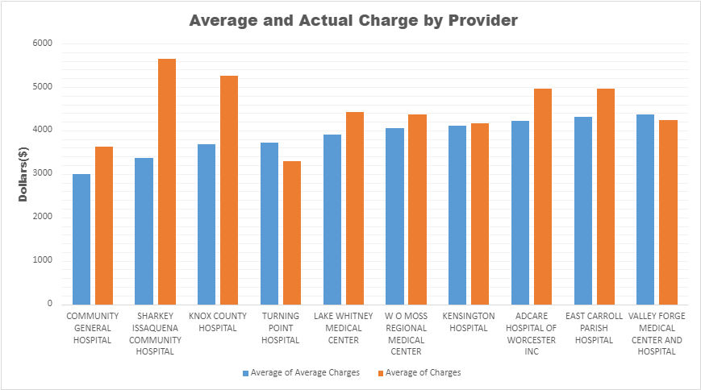
Figure 1.
Community general hospital appears to have the lowest average charges when compared to other providers.
The bar chart also indicates that Turning Point Hospital has the lowest actual charge out of all the providers

Slide 7
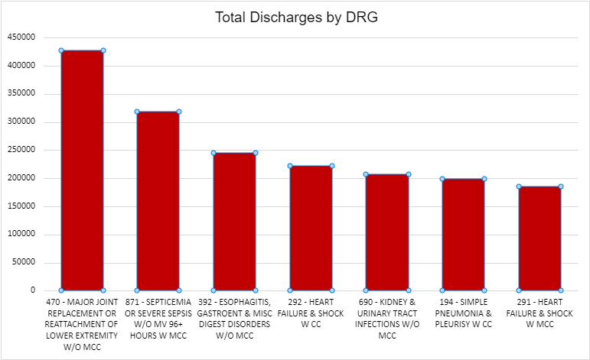
Figure 2.
From the graph, It is shown that 470- Major Joint replacement is the most common DRG that is treated
With a major drop in by over 10000 discharges until the next one(87)

Slide 8
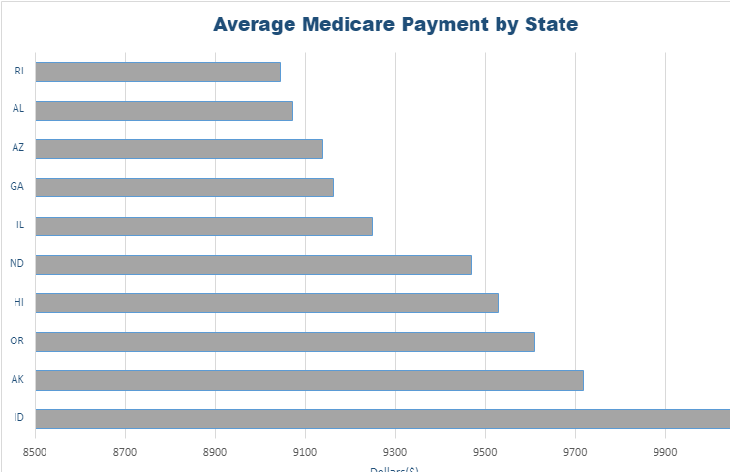
Figure 3.
Based on the bar graph showing the highest medicare states, it is observed that Idaho(ID) has the largest medicare amount
With states North Dakota, Hawaii, Orleans and Alaska having similar high medicare payments

Slide 9
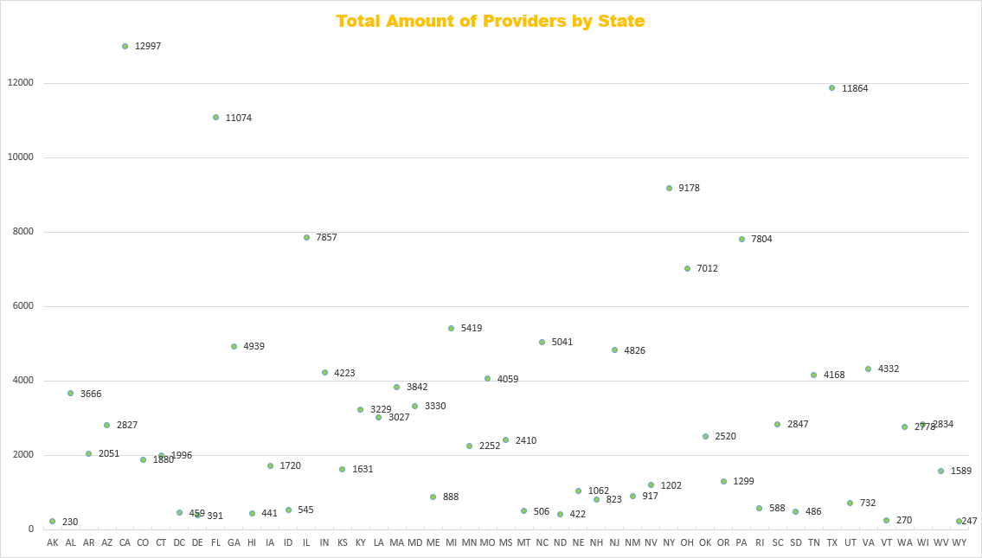
Figure 4.
It is deduced that the state of California contains the most providers by a wide margin
In contrast, the state of Alaska has the lowest amount of hospitals, with Wyoming being slightly higher

Slide 10
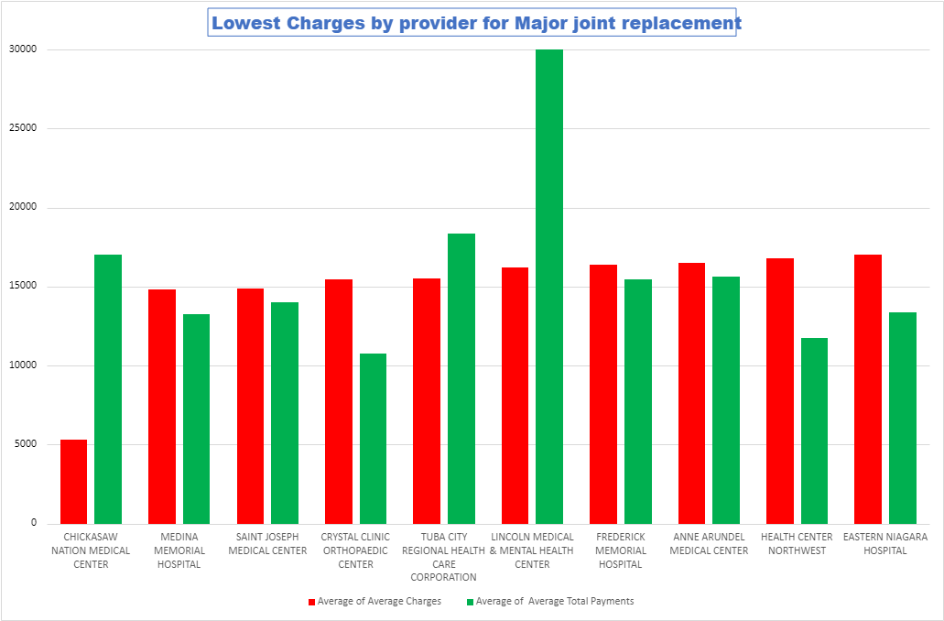
Figure 5.
The Double bar graph indicates Chickasaw hospital provides treatment for the most common DRG(Major joint replacement) for the lowest charge when compared to the rest of the data
While the Crystal Clinic Orthopaedic center has the lowest average of total payments when compared to other providers

Slide 11
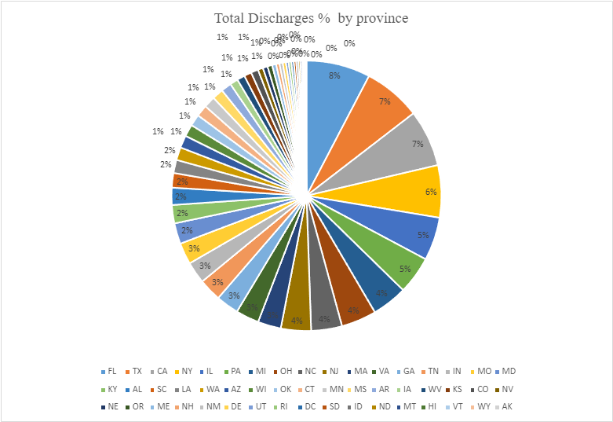
Figure 6
The Pie charts indicates the state of Florida has the highest percent of discharges, followed by texas
Alaska also contains the least amount of discharges followed by Wyoming. Showing similar results to Figure 4

Slide 12
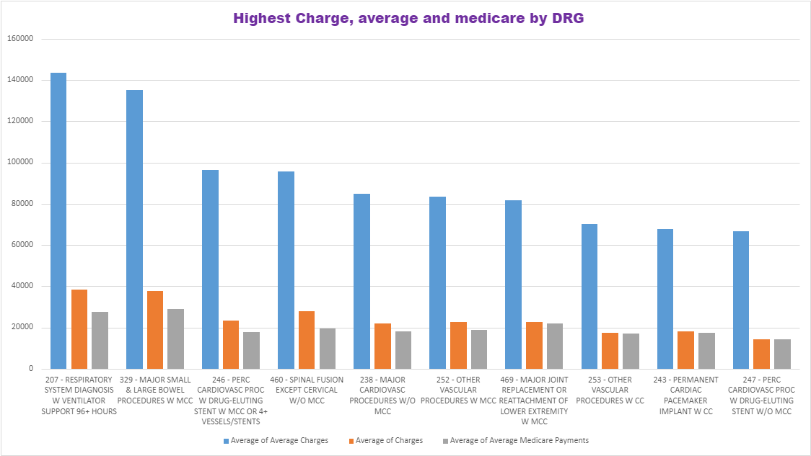
Figure 7.
The average charge of Respiratory is the highest among all DRG by a wide margin except major bowel procedures
Major bowel procedures and Respiratory diagnosis are also have the highest actual charge

Slide 13
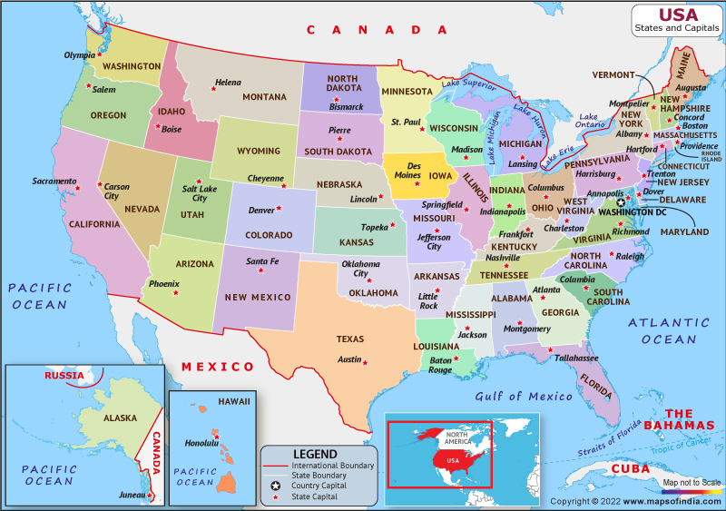
Conclusion
Detailed information on the geographic distribution of hospitals, allows people to seek the correct places and reduces delays in seeking care.
The report offers insights into the costs associated with healthcare services, helping patients make more informed decisions about their healthcare and financial choices.
Healthcare providers, policymakers, and insurance companies can utilize the data in the report to make informed decisions about resource allocation, facility planning, and cost containment strategies.
The report highlights geographic disparities in healthcare access and affordability, shedding light on areas where interventions is needed.
.

